Slide 1

WEB BROWSING

Slide 2
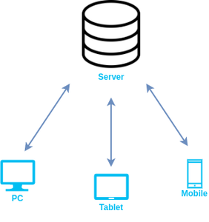
A web browser helps us find information anywhere on the internet. It is installed on the client computer and requests information from the web server such a type of working model is called a client-server model.

Slide 3

TYPES
1. Google Chrome:
Developed by Google, Chrome is one of the most widely-used web browsers in the world, known for its speed and simplicity.

Slide 4

2. Mozilla Firefox:
Developed by the Mozilla Foundation, Firefox is an open-source browser that is known for its privacy features and customization options.

Slide 5
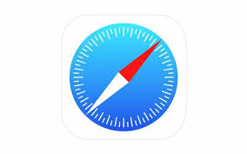
Apple Safari:
Developed by Apple, Safari is the default browser on Mac and iOS devices and is known for its speed and integration with other Apple products.

Slide 6

. Microsoft Edge:
Developed by Microsoft, Edge is the default browser on Windows 10 and is known for its integration with other Microsoft products and services.

Slide 7
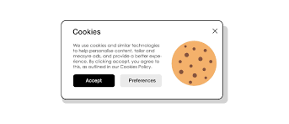
WEBSITE COOKIES
When we visited any website over the internet our web browser stores information about us in small files called cookies. Cookies are designed to remember stateful information about our browsing history. Some more cookies are used to remember about us like our interests, our browsing patterns, etc. Websites show us ads based on our interests using cookies.

Slide 8
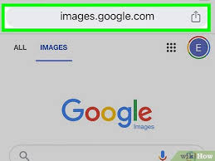

NAVIGATING WEBSITES
Type a website address (URL) into the browser’s address bar at the top of the screen and press Enter.
To search for something, type a word or phrase into the search bar (Google search, for example) and press Enter.

Slide 9
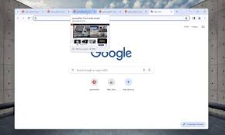
HOW TO OPEN MULTIPLE TABS?
Opening Multiple Tabs:
Click the + icon next to the current tab to open a new tab.
You can switch between tabs by clicking on each tab or using the keyboard shortcut Ctrl + Tab (Windows) or Command + Tab (Mac).

Slide 10
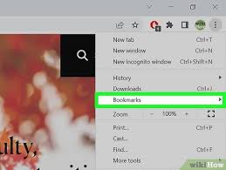
BOOKMARKS
Bookmarks help save and quickly access favorite or important webpages. They act like shortcuts, allowing users to revisit sites without searching again.
Using Bookmarks:
Bookmark a website by clicking the star icon in the address bar or using Ctrl + D (Windows) or Command + D (Mac).
To access your bookmarks, click on the three dots menu and go to Bookmarks

